Slide 1


Working of Check Box, List Box and Combo Box in Ado. Net using C# Code
Submitted by
ALTHAF S

Slide 2
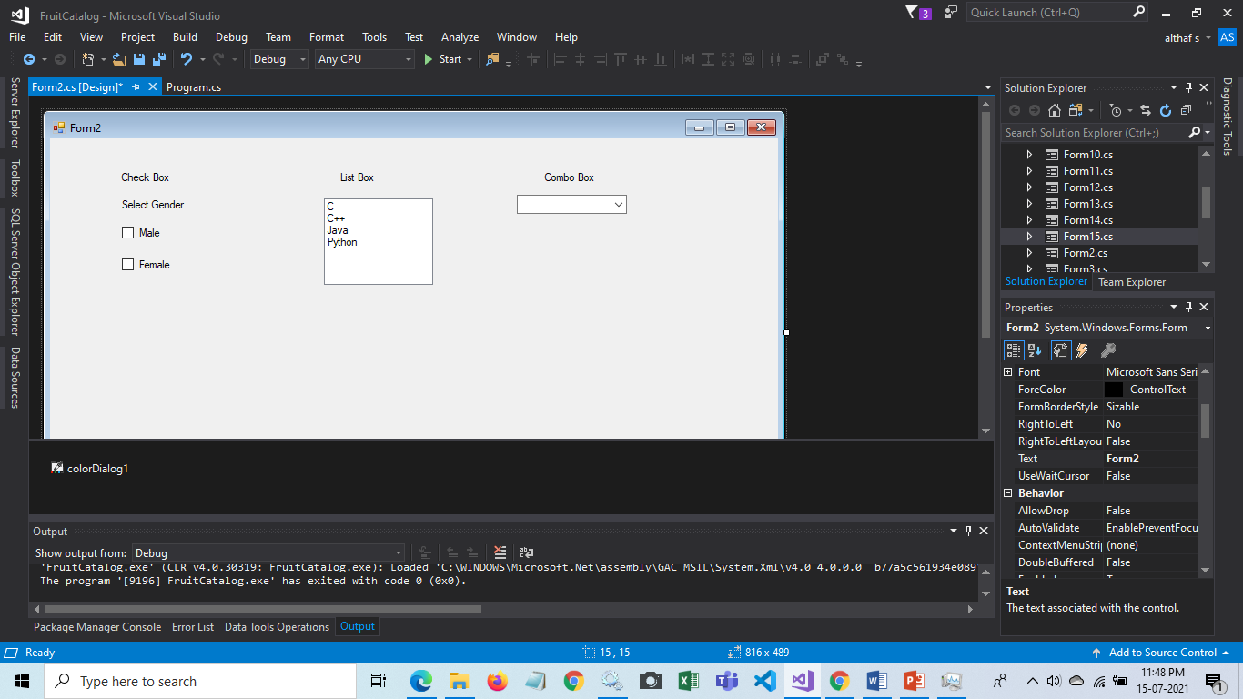
CheckBox Class
Use a CheckBox to give the user an option, such as true/false or yes/no. The CheckBox control can display an image or text or both.
To use these tools in your form Import the library System.Windows.Form.
Using Toolbox you can drag and drop Check, list and Combo box to your From.

Slide 3
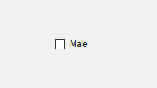
CheckBox Class
Example :
The following code example creates and initializes a CheckBox, gives it the appearance of a toggle button, sets AutoCheck to false, and adds it to a Form.
CODE :-
// Create and initialize a CheckBox.
CheckBox checkBox1 = new CheckBox();
// Turn off the update of the display on the click of the control.
//checkBox1.Appearance = Appearance.Button;
checkBox1.AutoCheck = true;
checkBox1.Text = "Male";
checkBox1.Location=new Point(125, 90);
// Add the check box control to the form.
Controls.Add(checkBox1);
OUTPUT :-
Output using code approach.

Slide 4
ListBox Class
The ListBox control enables you to display a list of items to the user that the user can select by clicking.
Example :
Using Toolbox you can drag and drop list box to your From.

Slide 5
OUTPUT :-
ListBox Class
Example :
The following code example demonstrates how to create a ListBox control that displays multiple items in columns and can have more than one item selected in the control's list.
CODE :-
// Create an instance of the ListBox.
ListBox listBox1 = new ListBox();
// Set the size and location of the ListBox.
listBox1.Size = new System.Drawing.Size(600, 300);
listBox1.Location = new System.Drawing.Point(10, 100);
// Add the ListBox to the form.
this.Controls.Add(listBox1);
// Set the ListBox to display items in multiple columns.
listBox1.MultiColumn = true;
// Set the selection mode to multiple and extended.
listBox1.SelectionMode = SelectionMode.MultiExtended;
// Shutdown the painting of the ListBox as items are added.
listBox1.BeginUpdate();
// Loop through and add 50 items to the ListBox.
for (int x = 1; x <= 50; x++)
{
listBox1.Items.Add("Item " + x.ToString());
}
// Allow the ListBox to repaint and display the new items.
listBox1.EndUpdate();
// Select three items from the ListBox.
listBox1.SetSelected(1, true);
listBox1.SetSelected(3, true);
listBox1.SetSelected(5, true);
// Display the second selected item in the ListBox to the console.
System.Diagnostics.Debug.WriteLine(listBox1.SelectedItems[1].ToString());
// Display the index of the first selected item in the ListBox.
System.Diagnostics.Debug.WriteLine(listBox1.SelectedIndices[0].ToString());
TextWriterTraceListener writer = new TextWriterTraceListener(System.Console.Out);
Debug.Listeners.Add(writer);

Slide 6
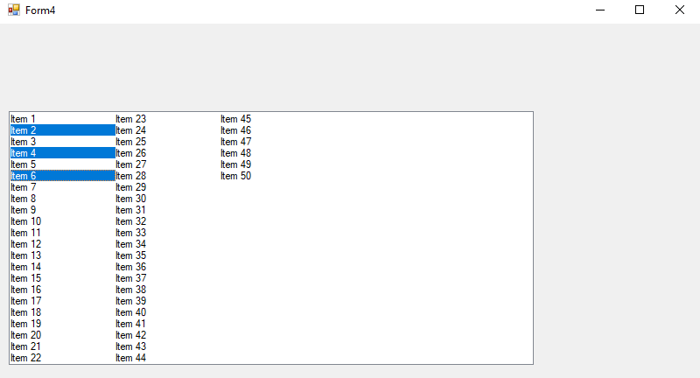
ListBox Class
OUTPUT :-
You can observe that multiple inputs got Selected in the list by using the code approach.
Output using code approach.

Slide 7
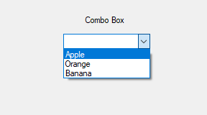
ComboBox Class
A ComboBox displays a text box combined with a ListBox, which enables the user to select items from the list or enter a new value.
Example :
Using Toolbox you can drag and drop Combo box to your From.

Slide 8
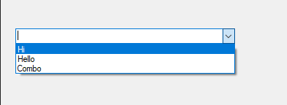
ComboBox Class
Example :
The following code example is a complete application showing how you can use the Add method to add items to a ComboBox, the FindString method to find items in a ComboBox, and the BeginUpdate and EndUpdate methods to efficiently add a large number items to a ComboBox.
CODE :-
OUTPUT :-
ComboBox combo1 = new ComboBox();
combo1.Location = new Point(20, 100);
combo1.Size = new Size(300, 40);
combo1.Items.Add("Hi");
combo1.Items.Add("Hello");
combo1.Items.Add("Combo");
this.Controls.Add(combo1);
Output using code approach.

Slide 9



